Slide 1



A Shepherd? DQN is All You Need！
Group：Lovely Sheep Team
Artificial Intelligence Institution
Dec.24th 2021

Slide 2




Background
Task Analysis
OutLine
Approach
Responsibility

Slide 3
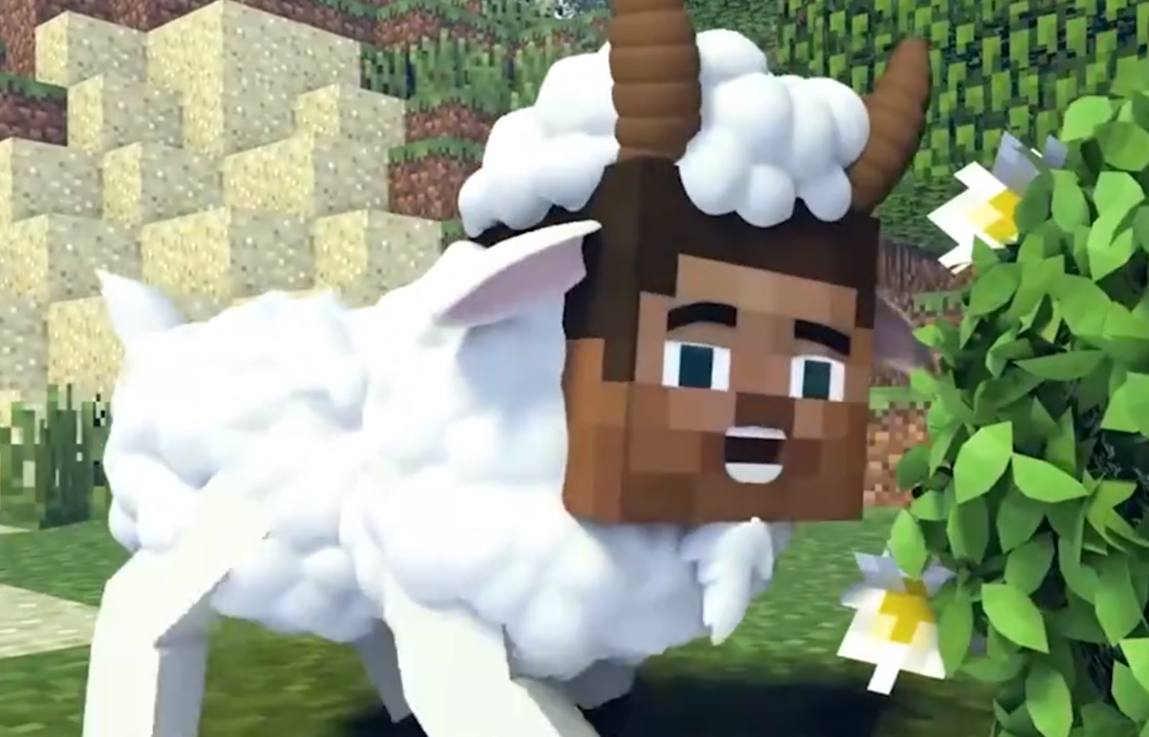



BackGroundluring sheep on MineCraft
Luring Sheep
Task Analysis
Approach
Responsibility
How to Train an Agent ...?
Main Goal: lure the sheep and bring it to the cote
Platform: PythonMalmo

Slide 4
Background
Task Analysis
OutLine
Approach
Responsibility

Slide 5
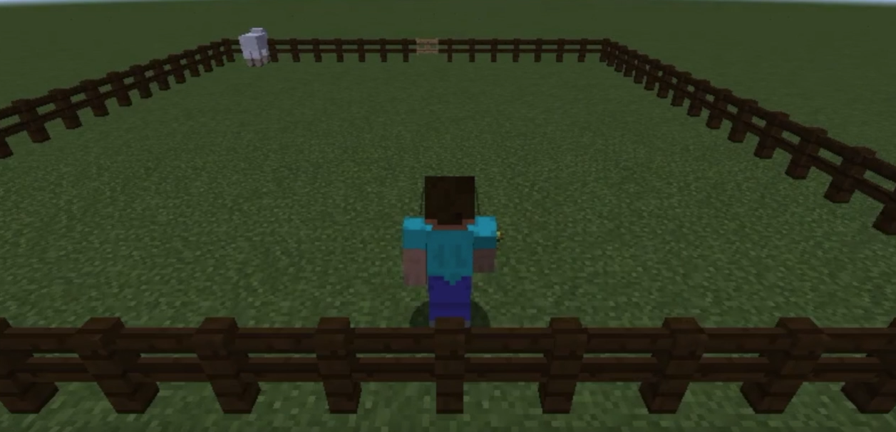
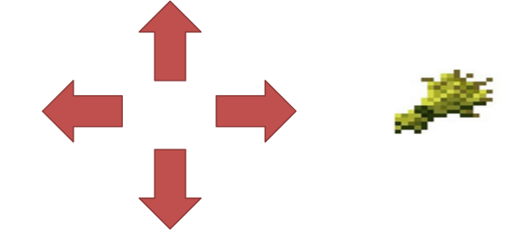

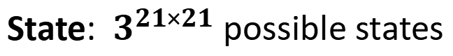
TaskAnalysismap state policy
Luring Sheep
Map State Policy
Approach
Responsibility
Reward Function
Map: 21×21 with cotes formed a square
State: ${ 3}^{21×21}$ possible states
Cost at least $2.5×{10}^{111}$TB Memory to hold a Q-Table
Consider using Deep Q-learning algorithm
Tabluar Q-learning is not fitable！
Action: 6 move around, take out wheat, do nothing

Slide 6
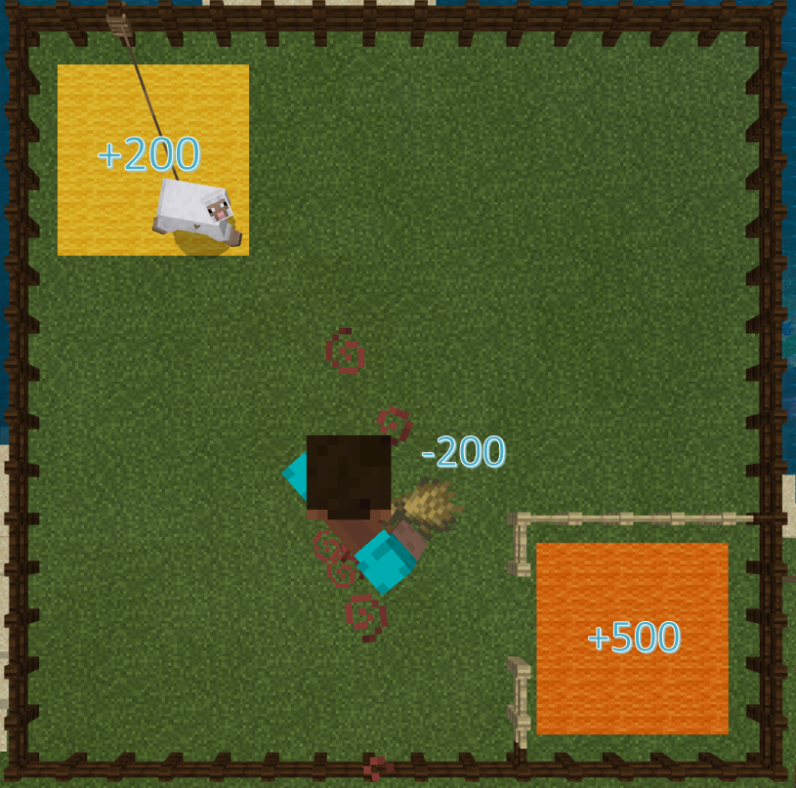
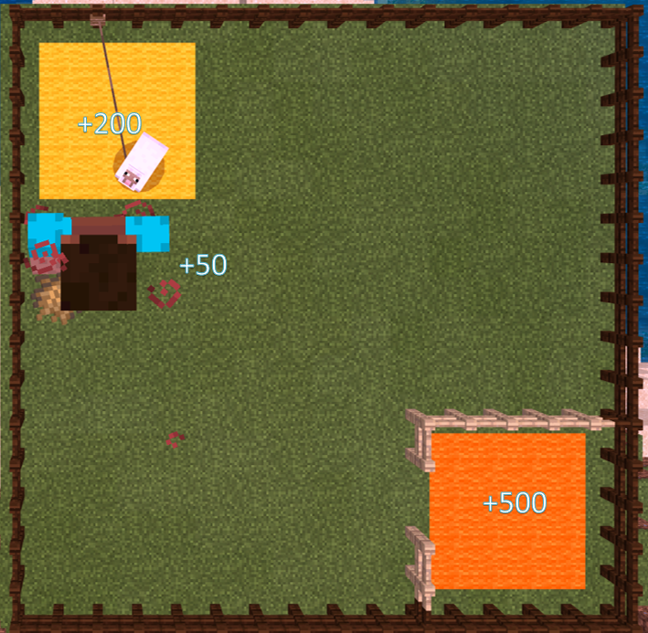

TaskAnalysisreward function
Luring Sheep
Map State Policy
Approach
Responsibility
Reward Function
Using Reward Function to TALK with Steve！—Steve Aspect
Far from sheep(dist>4)
Closed to sheep(dist<4)
Take Out Wheat：(+)
Take Out Wheat： (+)
In pan： (+)
Continuous Taking Wheat：(—)
Continuous Taking Wheat： (+)
Fig1. Reward of “Far From Sheep” Situation
Fig2. Reward of “Closed To Sheep” Situation
$$dist=\sqrt{{(x−x_{s})}^{2}+{(y−y_{s})}^{2}}$$

Slide 7
Background
Task Analysis
OutLine
Approach
Responsibility

Slide 8

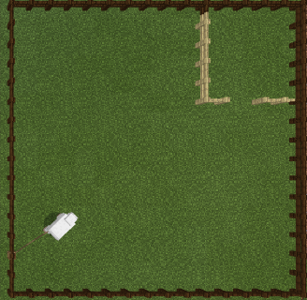
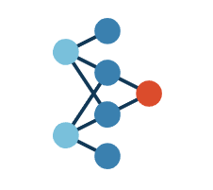

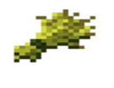
ApproachIntroduction
Luring Sheep
Task Analysis
Introduction
Responsibility
How DQN works in this Game? Here are PipeLine
＄
＄
＄
＄
＄
Get Current Environment From MalMo
Neural Value Function
Value of Each actions

Slide 9
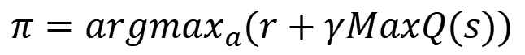
ApproachIntroduction
Luring Sheep
Task Analysis
Introduction
Responsibility
How DQN works in this Game? Here are PipeLine
$$π={argmax}_{a}(r+γMaxQ(s))$$
＄
＄
＄
＄
＄
Get Current Envirenment From MalMo
Neural Value Function
Value of Each actions

Slide 10
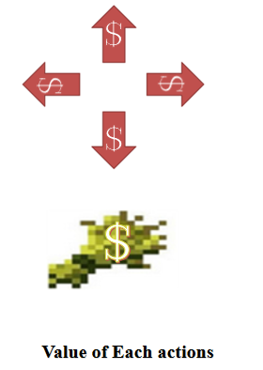
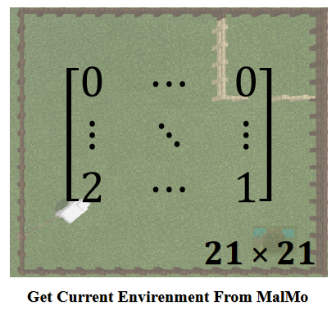
ApproachIntroduction
Luring Sheep
Task Analysis
Introduction
Responsibility
How DQN works in this Game? Here are Input Output Form!
Using a Matrix to Represent Map
Using a Vector to Represent Available Actions
0：grass block
1: steve
2: sheep
[north, south, east, west, show, hide, tp]

Slide 11
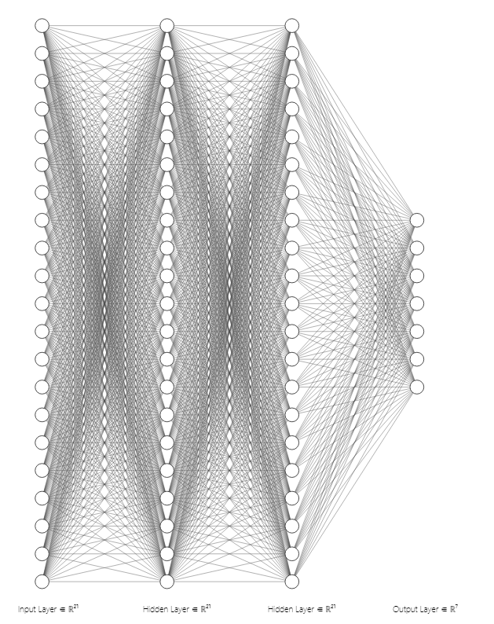
ApproachBaseLine
Luring Sheep
Task Analysis
BaseLine
Responsibility
Our BaseLine—A DenseNet Based Value Function
Neural NetWork Architecture

Slide 12
ApproachBaseLine
Luring Sheep
Task Analysis
BaseLine
Responsibility
Our BaseLine—A DenseNet Based Value Function
Reward Function—Steve Aspect—Sheep Aspect
Far from pan(dist>50)
Far from sheep(dist>4)
Closed to sheep(dist<4)
Variable Reward: (-dist)
Take Out Wheat：(-200)
Take Out Wheat： (+50)
Close to pan(dist<4)
Variable Reward： (-dist)
Fixed Reward： (+100)
Fixed Reward:(+100)
Fig1. Reward of “Far From Sheep” Situation
Fig2. Reward of “Closed To Sheep” Situation
Fig3. Reward of “Closed To Pan” Situation

Slide 13
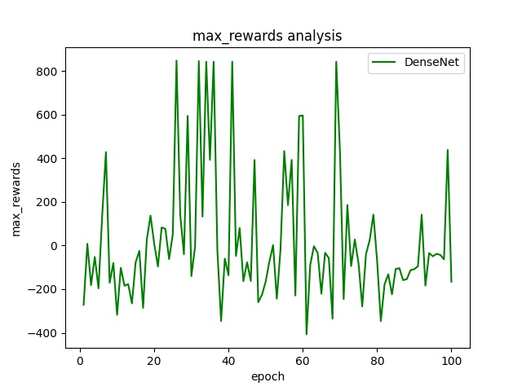
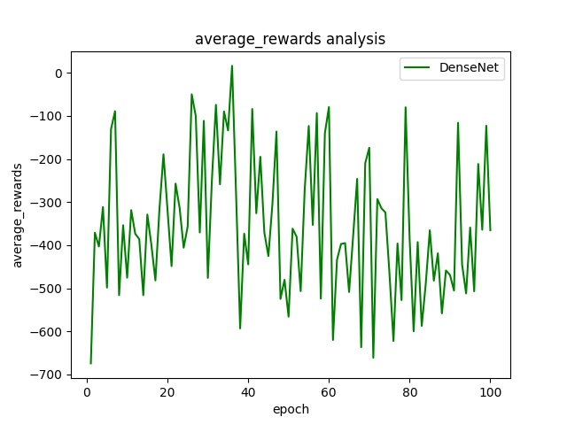
ApproachBaseLine
Luring Sheep
Task Analysis
BaseLine
Responsibility
Our BaseLine—A DenseNet Based Value Function
Experiment1-low Efficience！！！
Reward | Value
average | -354.71
max | 20.91
loss | 15603.88
DenseNet Really work! But It’s Unstable and Learn a little thing...

Slide 14
ApproachBaseLine
Luring Sheep
Task Analysis
BaseLine
Responsibility
Our BaseLine—A DenseNet Based Value Function
Experiment1-low Efficience！！！
DenseNet Really work! But It’s slow and Learn a little thing...
ParametersNum：441×441×2+441×7
TakingTime：about 2.5 hours

Slide 15
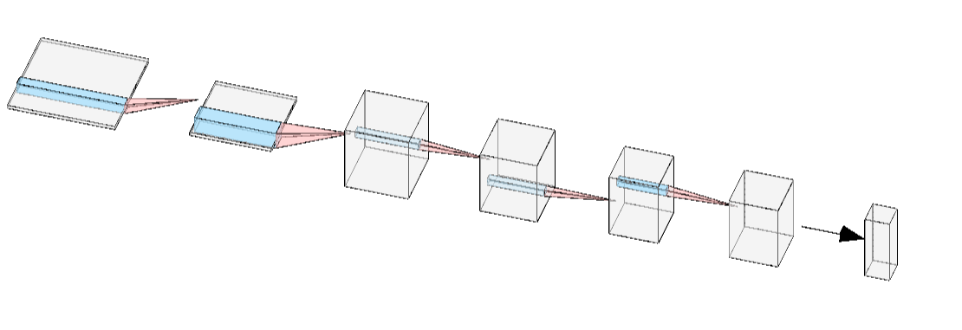
ApproachCNN
Luring Sheep
Task Analysis
CNN
Responsibility
Optimization1—Lighter, Faster, Stronger
CNN Architecture

Slide 16
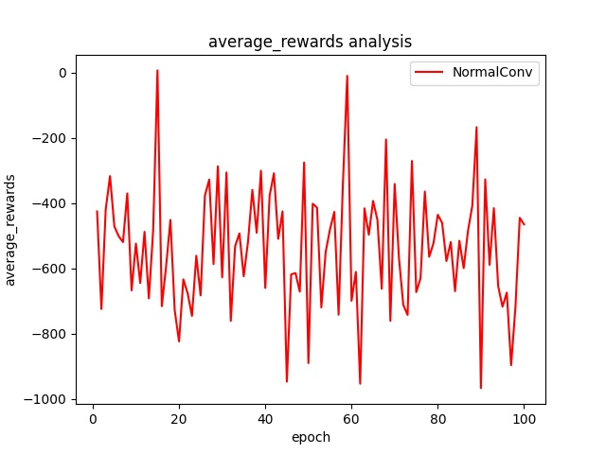
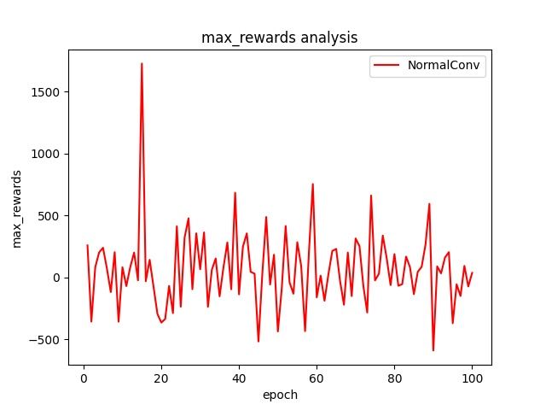
ApproachCNN
Luring Sheep
Task Analysis
CNN
Responsibility
Optimization1—Lighter, Faster, Stronger
Experiment2-Not ALL the sheep have been CAUGHT!
Reward | Value
average | -535.49
max | 64.52
loss | 130079.05
Normal CNN Architecture Finish the task successfully, but it’s not so good!

Slide 17
ApproachCNN
Luring Sheep
Task Analysis
CNN
Responsibility
Optimization1—Lighter, Faster, Stronger
ExperimeExperiment2-Not ALL the sheep have been CAUGHT!
Layer：[2×2Conv, 2×2Pool]×2+
GlobalPool+FCN
Normal CNN Architecture Finish the task successfully, but it’s not so good!
TakingTime：about 1 hours

Slide 18
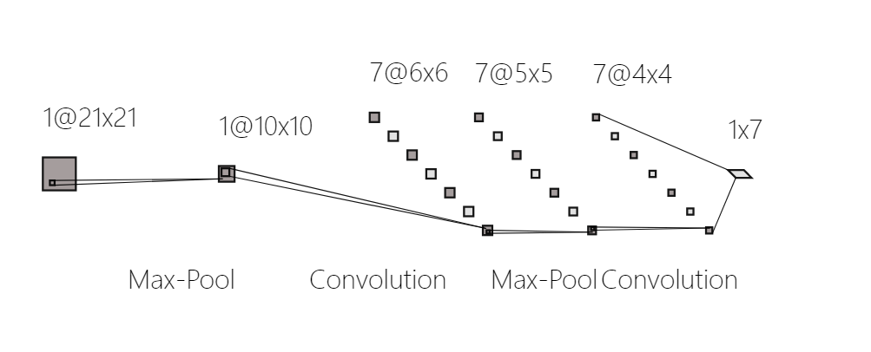
ApproachReLaCNN
Luring Sheep
Task Analysis
ReLaCNN
Responsibility
Optimization2—Delicate Designed Conv
Delicate Design CNN Architecture—Reasonable, Fittable!
Position Bluring
Decrease 75% searching
space
Trans Positon Space to Action Space
A MLP-like architecture for learning

Slide 19
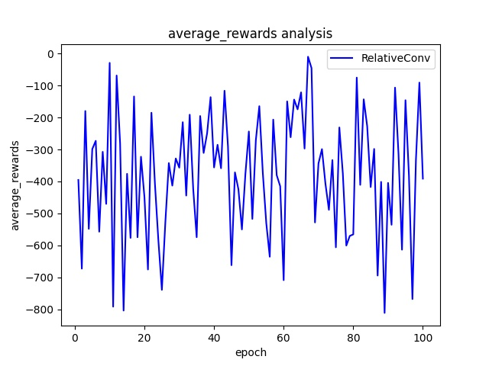
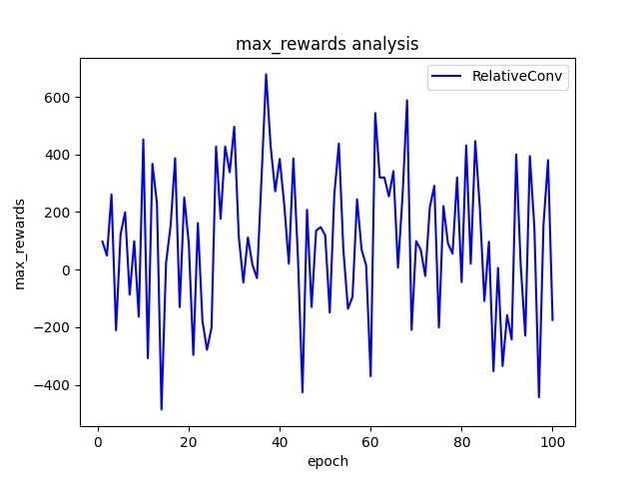
ApproachReLaCNN
Luring Sheep
Task Analysis
ReLaCNN
Responsibility
Optimization2—Lighter, Faster, Stronger, Fittable
Experiment3- ALL the sheep can be CAUGHT!
Reward | Value
average | -377.71
max | 99.720
loss | 77064.49
Delighted Designed CNN Architecture Has a Higher max reward than Rough CNN

Slide 20
ApproachReLaCNN
Luring Sheep
Task Analysis
ReLaCNN
Responsibility
Optimization2—Lighter, Faster, Stronger
Experiment3- ALL the sheep can be CAUGHT!
Delighted Designed CNN Architecture Finish the task successfully !

Slide 21
Questionanalysis
Luring Sheep
Task Analysis
More Open?
Responsibility
WHAT’s Wrong with Steve??
1. Automatically get back when touch a sheep
2. Sometimes Steve cought a sheep by Luckiness

Slide 22
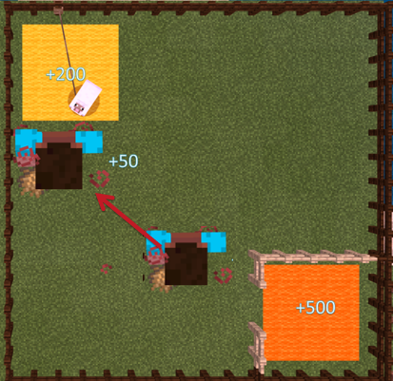
ApproachTDreward
Luring Sheep
Task Analysis
TDreward
Responsibility
Optimization3—Only Result?! No! Process makes difference!
Experiment5-Temporal Differencial Reward
Hinge Reward：Only Focus Result
TDreward(t)=sgn(dist(t-1)-dist(t))·[C+|dist(t-1)-dist(t)|]

Slide 23
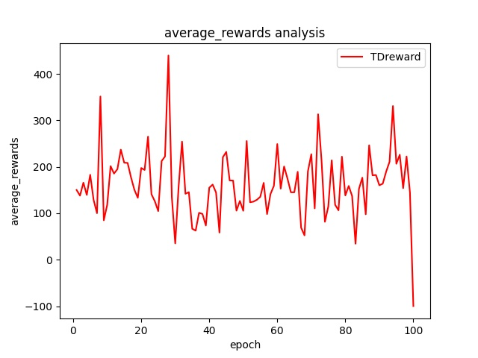
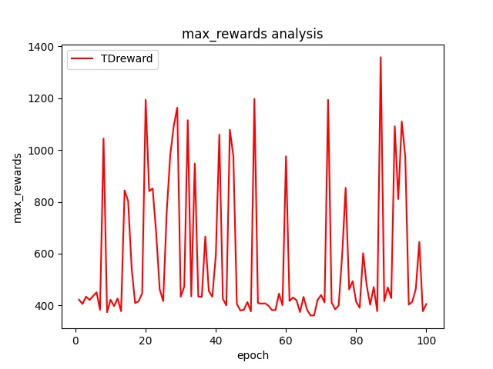
ApproachTDreward
Luring Sheep
Task Analysis
TDreward
Responsibility
Optimization3—Only Result?! No! Process makes difference!
Experiment5-Temporal Differencial Reward
Reward | Value
average | 161.21
max | 573.51
loss | 573.51
Achieve SOTA: TDreward has the highest reward and lowest average loss

Slide 24
ApproachTDreward
Luring Sheep
Task Analysis
TDreward
Responsibility
Optimization3—Only Result?! No! Process makes difference!
Experiment5-Temporal Differencial Reward
TDreward(t)=sgn(dist(t-1)-dist(t))·[C+|dist(t-1)-dist(t)|]
TD reward generate a more intelligent agent!

Slide 25
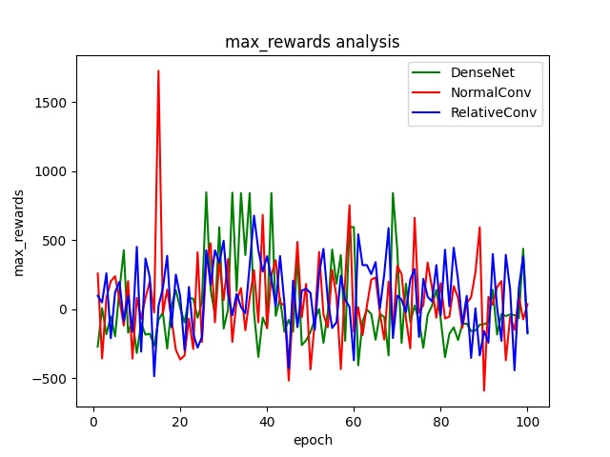
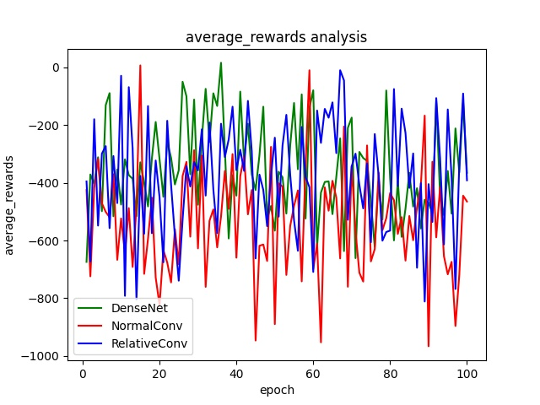
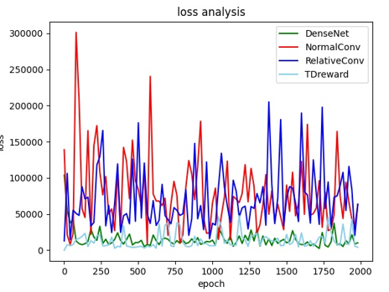
ApproachComparison
Luring Sheep
Task Analysis
Comparison
Responsibility
Comparison—ReLaCNN+Tdreward Get SOTA Result!!! We are champion!
Reward | TDReward+ReLaCNN | ReLaCNN | NormCNN | DenseNet
average | 161.21 | -377.71 | -535.49 | -354.71
max | 573.51 | 99.720 | 64.52 | 20.91
loss | 573.51 | 77064.49 | 130079.05 | 15603.88

Slide 26
Background
Task Analysis
OutLine
Approach
LET US SHOW YOU

Slide 27
Presentation
Luring Sheep
Task Analysis
More Open?
Responsibility
Experiment6-Our Attempt
Here Is The Whole Process of Learning 300 epochs!
TDreward(t)=sgn(dist(t-1)-dist(t))·[C+|dist(t-1)-dist(t)|]
TD reward can really work in this set! We generate a stratrgy agnet!!!

Slide 28
THANK YOU！
2021年12月24日

Slide 29

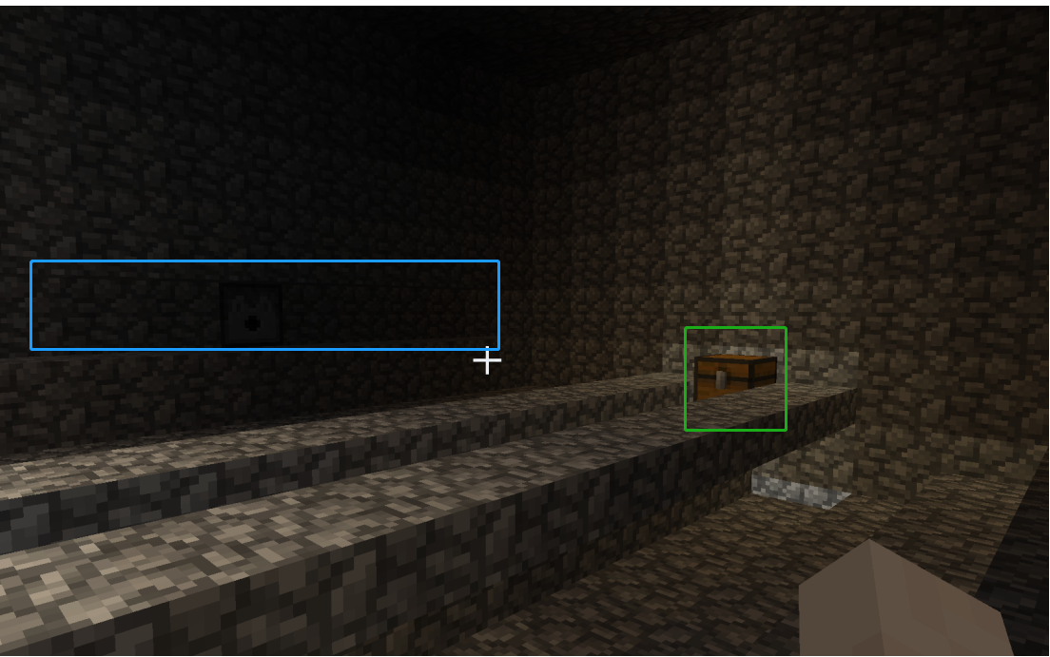
任务描述
任务背景
算法介绍
参数设置
算法效果以及分析
寻宝特工
这个任务的目标是让我们的agent学会如何在弓箭雨中学会穿过人行道达到最后的宝箱，我们需要通过强化学习算法来学习如何躲避这些弓箭。
我们通过rl算法让agent在多种弓箭雨模式下学会在长度为10的道路上通过前进与暂停两个动作再不受伤的情况下顺利达到终点宝箱。
弓箭区域
宝箱域

Slide 30
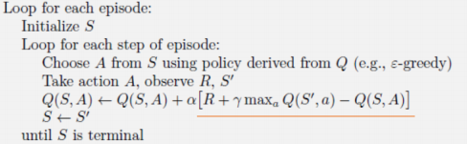
算法介绍
任务背景
算法介绍
参数设置
算法效果以及分析
Q-learning算法
伪代码：
从伪代码中可见，我们主要需要考虑的有对R的设定以及S中的参数数量，此外我们还需要考虑一次loop到下一次loop的时间，即Q表更新的频率（给出动作的频率），过快的频率会导致角色可能一瞬间冲到终点。

Slide 31
参数设置
任务背景
算法介绍
参数设置
算法效果及分析
Q表更新方式
初始化reward为1
1.判断此时是否被击中，被击中则会返回reward-10，成功标志False
2.若没被击中，reward+10，成功标志True
3.如果前一步动作为暂停，reward*0.8
4.如果成功躲避过弓箭，reward+=20

Slide 32
参数设置
任务背景
算法介绍
参数设置
算法效果及分析
主要函数以及参数设置
参数：
self.alpha 学习率：0.5 尝试了0.25，0.5，1 其中0.5效果最好
Self.gamma 损失率：0.95
Self.epsilon epsilon-greedy中随机动作的比例：0.2
Self.sleeptime 从上一个动作结束到下一轮计算动作开始的间隔时间：0.05
函数：
def get_current_state(obs):获得路径信息以及全部弓箭位置
def damaged(state):判断agent是否被弓箭击中
def complete(state):判断是否达到终点, 判断面前第一个物品是否为箱子
def avoid_arrow(state):判断是否被弓箭造成伤害

Slide 33
算法分析
任务背景
算法介绍
参数设置
算法分析以及效果
Q表分析
弓箭位置以及数量设置
该人物中影响agent行动的因素主要有：箭的数量、箭的位置、角色的位置，即S变量由这些因素组成，Q表也需要有相应的大小来对应这些状态。下面我们将具体分析这些因素对于Q表大小的影响。
箭的数量范围在1-4，角色可达位置为10块，弓箭的可能位置有10个，Q表大小范围在100-400。
使用下面五种弓箭发射器分布，分别进行实验

Slide 34
算法效果
任务背景
算法介绍
参数设置
算法分析以及效果
胜率统计
从左图的数据中可以看出此时基本满足随着弓箭数量的增多，问题难度增大，胜率降低的特点

Slide 35
THANK YOU！
2021年12月24日

